Slide 1

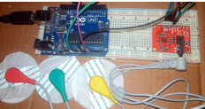
BRAIN-COMPUTER INTERFACE SYSTEMS AND APPLICATIONS
A Study on Real-Time Device Control, Remote Typing, and Neuro-Gaming
NEURAL ADMINS
Tamilnadu Government Polytechnic College (Autonomous), Madurai-11
Department of Computer Engineering

Slide 2


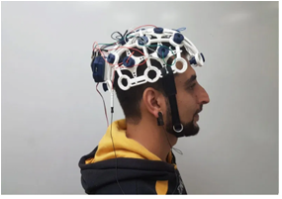






Motivation & Objectives
Motivation
To assist physically challenged users in interacting with digital systems using neural signals and eye movements.
Key Objectives
Detect eye movements (left, right, blink) using EOG signals
Use EEG-based attention/blink strength for system control
Control LEDs and external devices via neural signals
Enable remote keyboard typing using eye movements
Develop neuro-gaming interfaces for games like Subway Surfers and Beach Buggy Racing

Slide 3

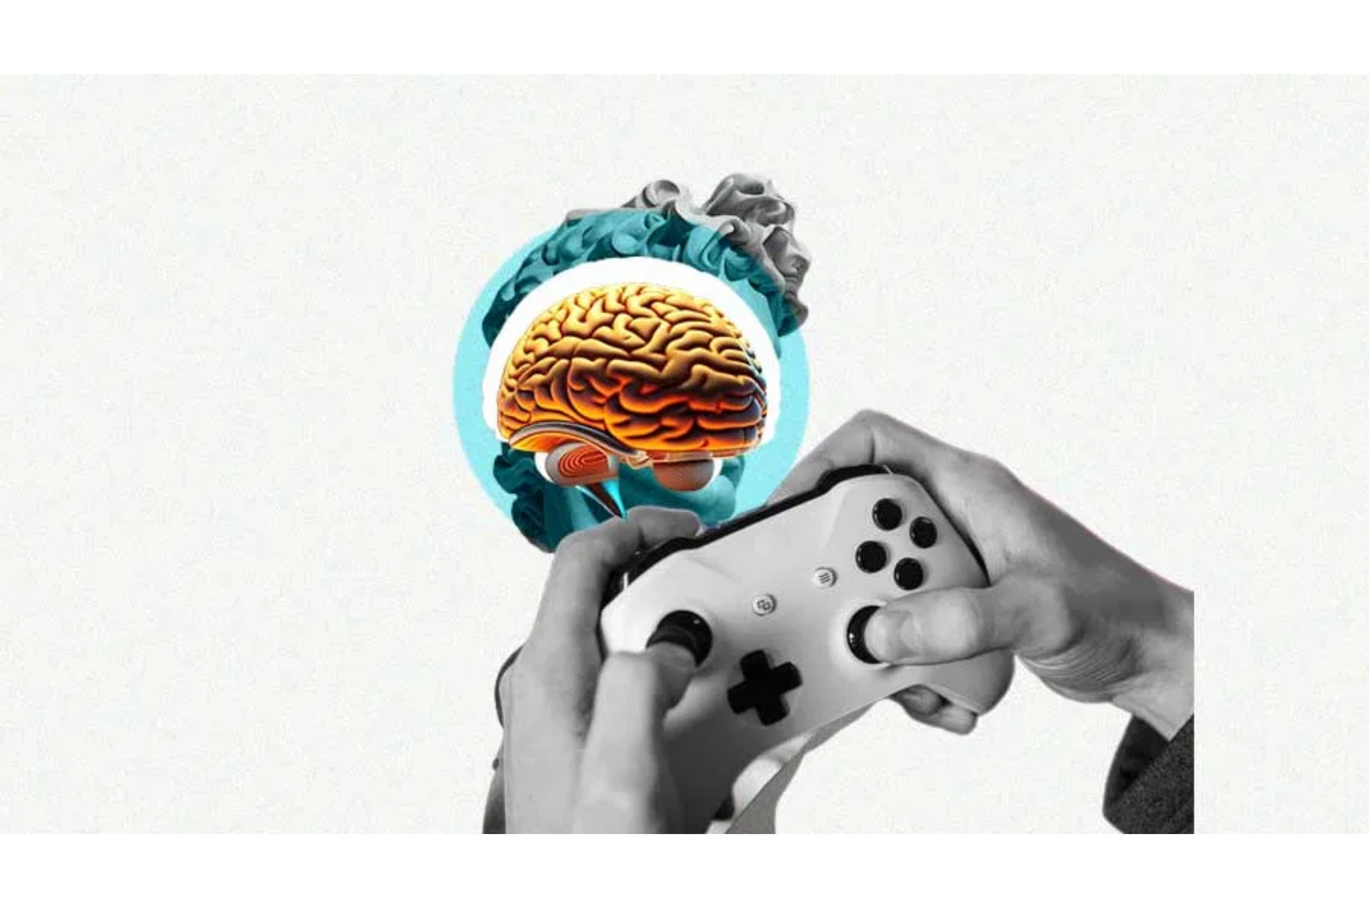

BCI Workflow & Process Flow
The complete BCI workflow includes 7 critical steps from brain activity detection to output action.
1
Brain Activity Detection
2
Signal Acquisition
3
Signal Preprocessing
4
Feature Extraction
5
Signal Analysis
6
Action Mapping
7
Output Action
Key Step: Action Mapping (Step 6)
Translates analyzed signals into specific commands like keyboard keys or device control signals.

Slide 4




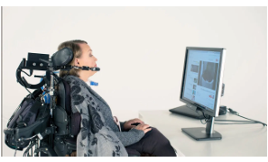








Methodology
1. Signal Acquisition
Device: EXG sensor with Arduino Uno
Placement: Forehead and surrounding eye muscles
Signals: EOG (horizontal/vertical), EEG (blink/attention waves)
2. Signal Processing
Thresholding & Filtering of noise
Python for live signal plotting and control logic
Real-time serial communication for control signals
3. Applications Developed
Smart Light Blinking System → Controlled LED using blink detection
Remote Keyboard → Navigate and select characters using eye movements
Gaming Interface → Play games by mapping eye/blink signals to keyboard inputs

Slide 5




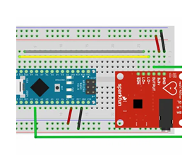











Tech Stack
Hardware
EXG sensor
Arduino Uno
Electrodes & cables
Software
Python
pySerial
pynput
Processing
Tools
Jupyter Notebook
Notepad
BB Racing
Subway Surfers

Slide 6



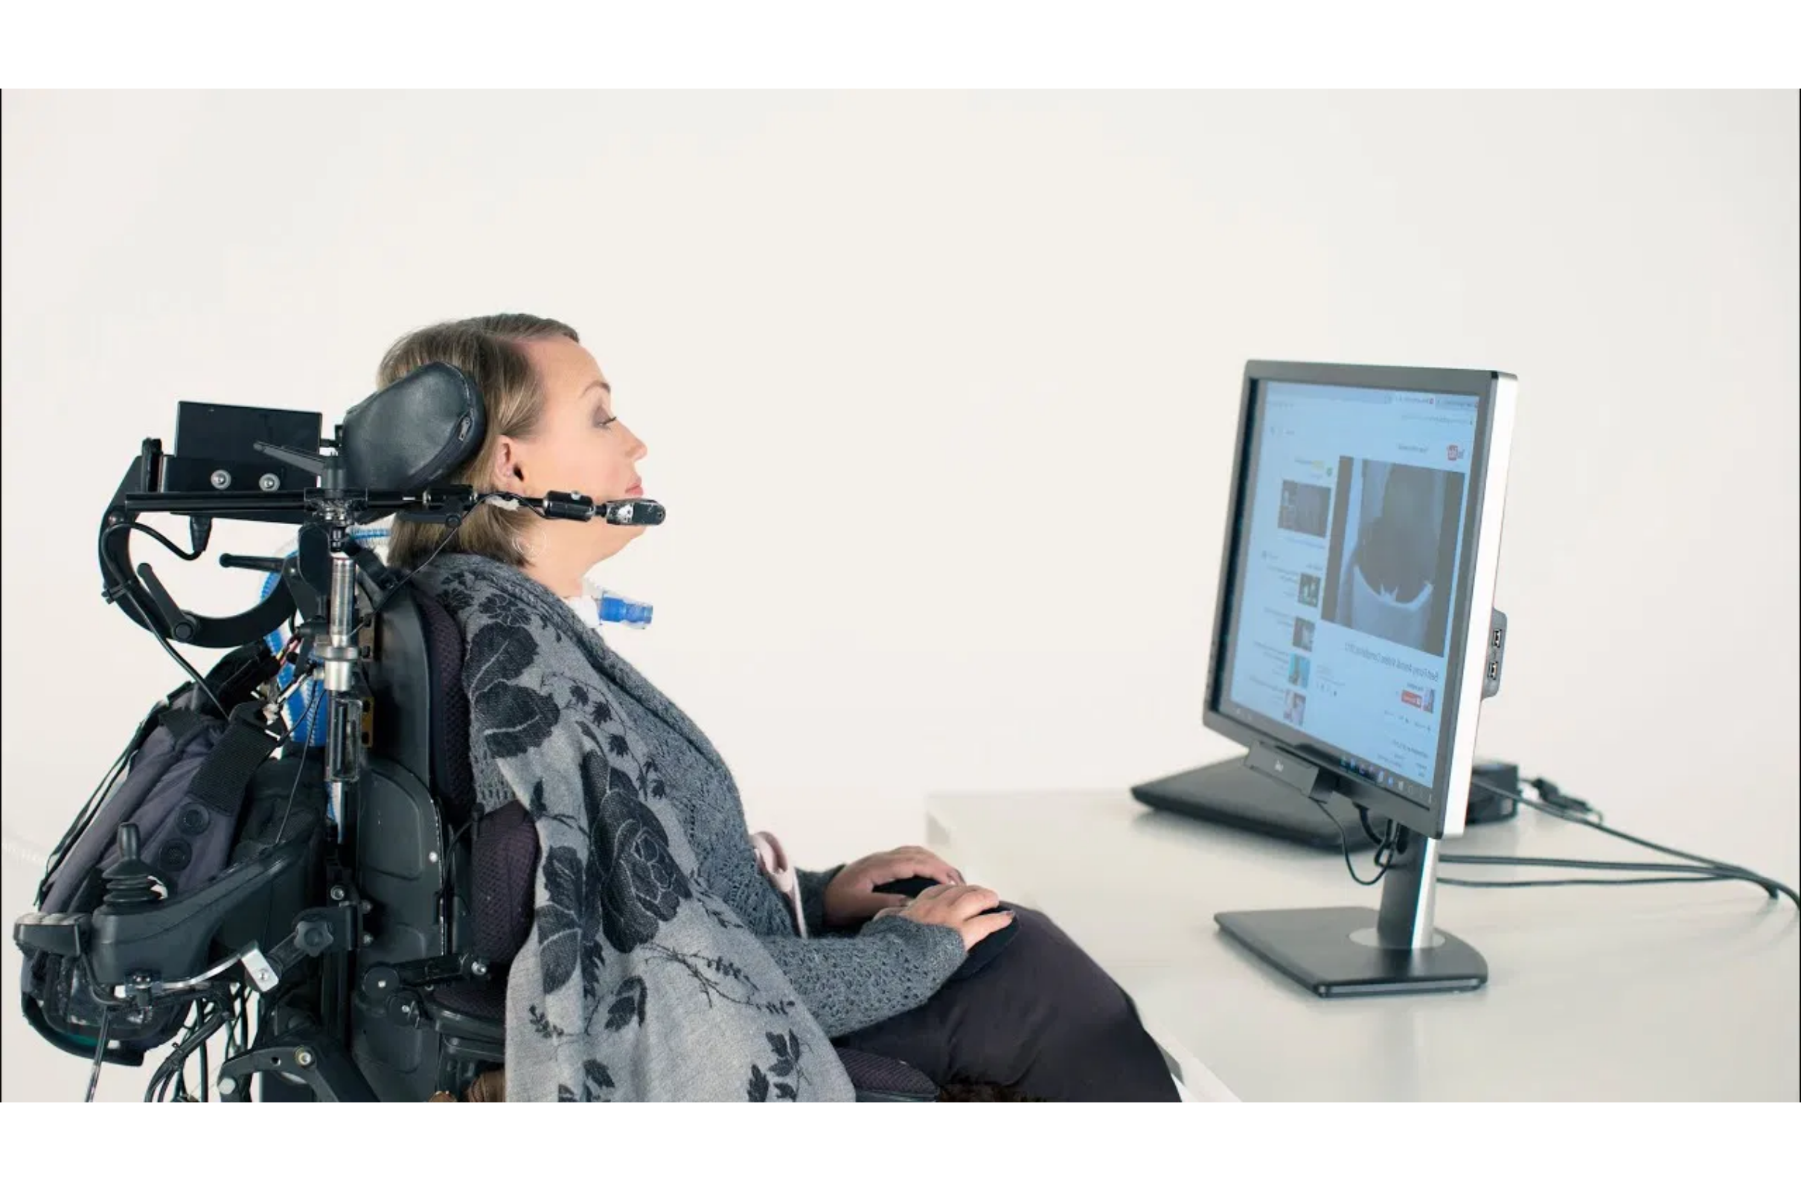
What Makes Our BCI Unique
Our BCI system offers several advantages over existing commercial solutions:
Feature
Existing Systems
Our Contribution
Hardware
Expensive BCI headsets
Low-cost EXG sensor + Arduino
Platform
Closed-source software
Open-source + Python control system
Game Integration
Only tested in EEG toy apps
Integrated with real Android/PC games
Typing Interface
Basic cursor movement
Remote keyboard typing using eye signals
User Training
Requires ML-based calibration
Threshold-based, plug-and-play
Output Variety
Mostly binary control
LED, Notepad, Game, etc.

Slide 7




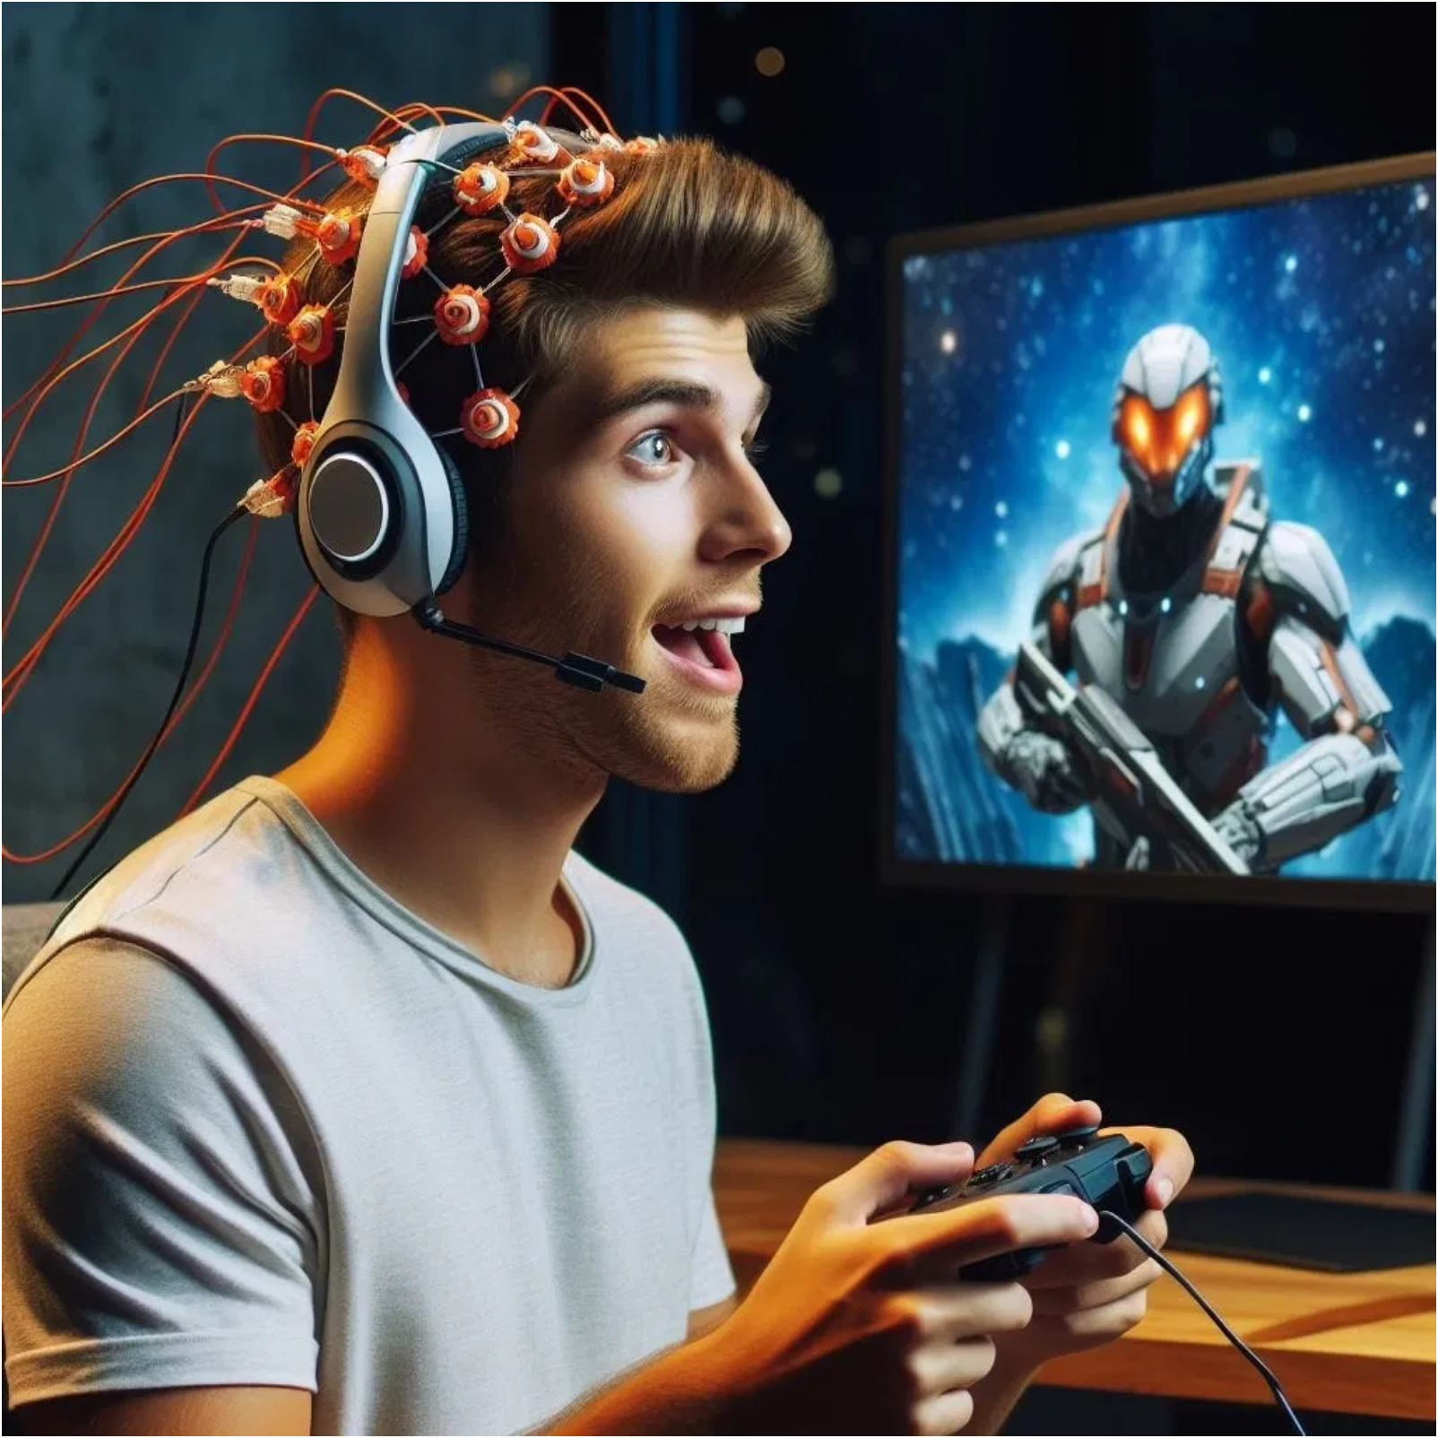


How It Works
1. EOG-Based Eye Movement Detection
Left Eye Movement: Signal drops below negative threshold
Right Eye Movement: Signal rises above positive threshold
Blink Detection: Sudden spike in amplitude above blink threshold
Signal Mapping:
Left arrow ←
Left eye movement
Right arrow →
Right eye movement
Space bar
Blink
2. EEG-Based Control
Utilizes blink strength or mental focus (beta/alpha wave variations)
Used for remote keyboard and game power-ups
Threshold-based detection for reliable control

Slide 8



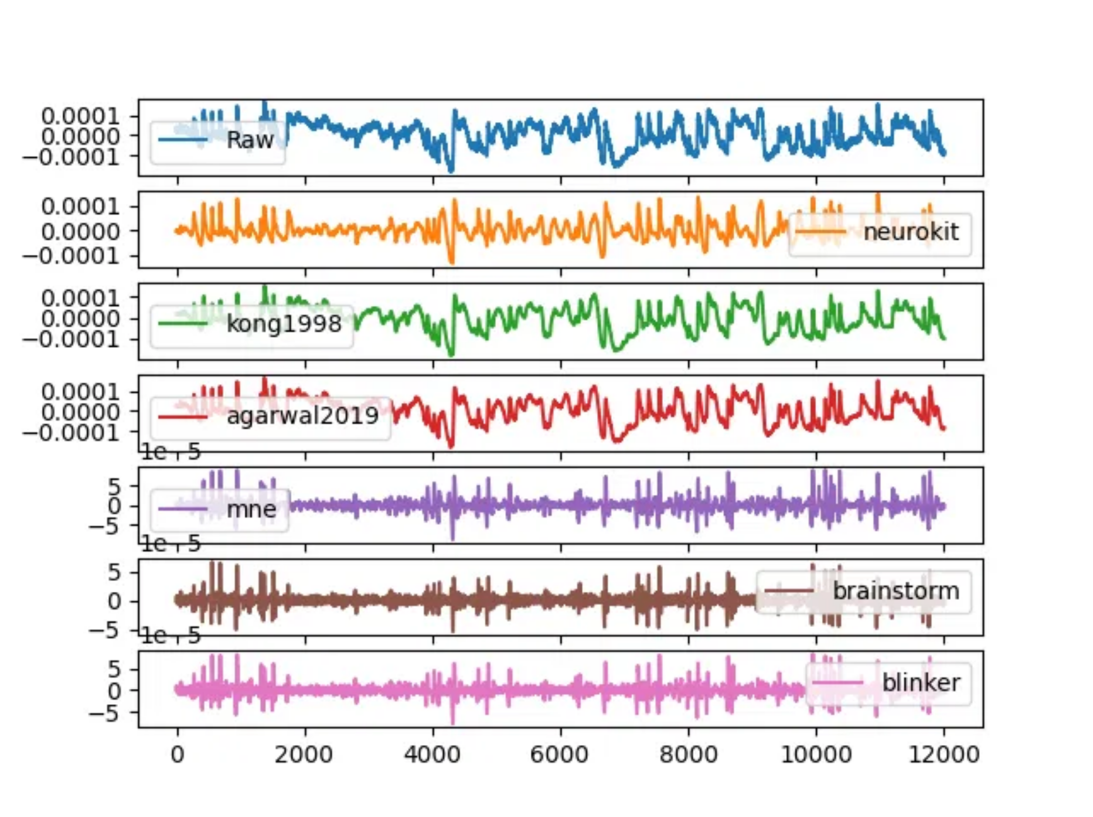
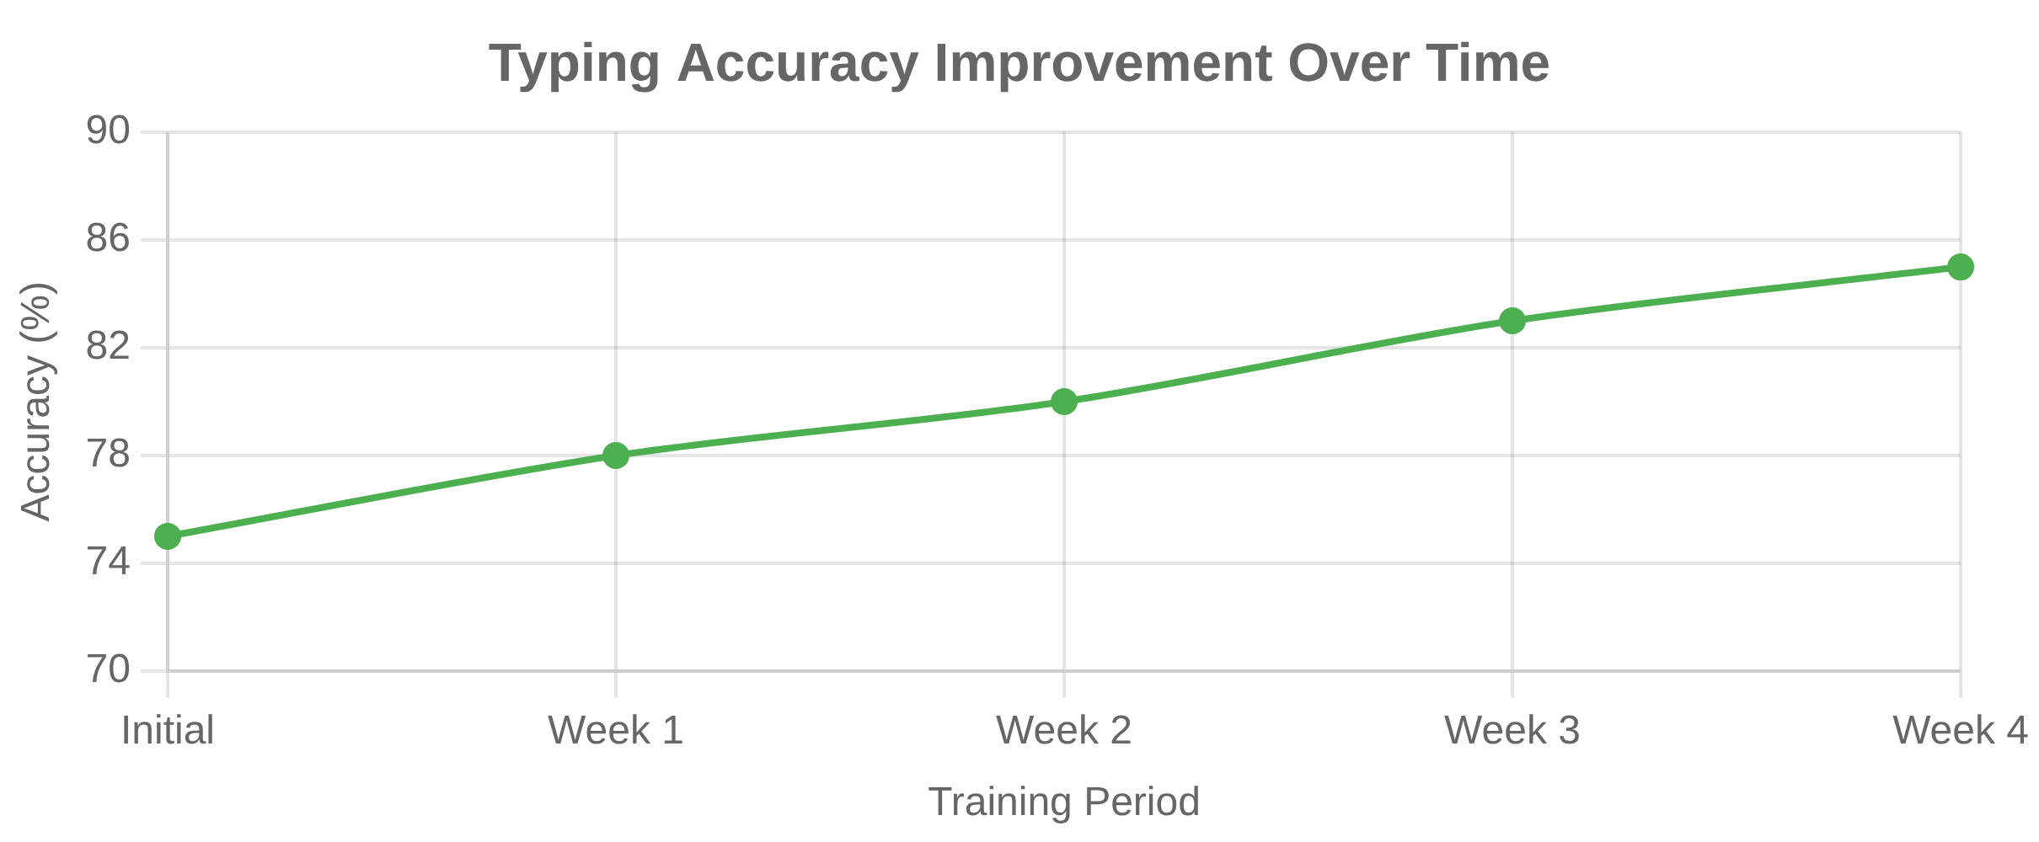


Results & Performance
Key Performance Metrics
Real-time blink detection with < 300ms delay
Reliable left/right EOG signal classification using threshold method
Validation Results
LED response to EEG blinks validated hardware control
Typing accuracy improved with practice (from 75% to 85%)
Game control was smooth with only minor delays
Successfully controlled in-game characters using neural signals

Slide 9


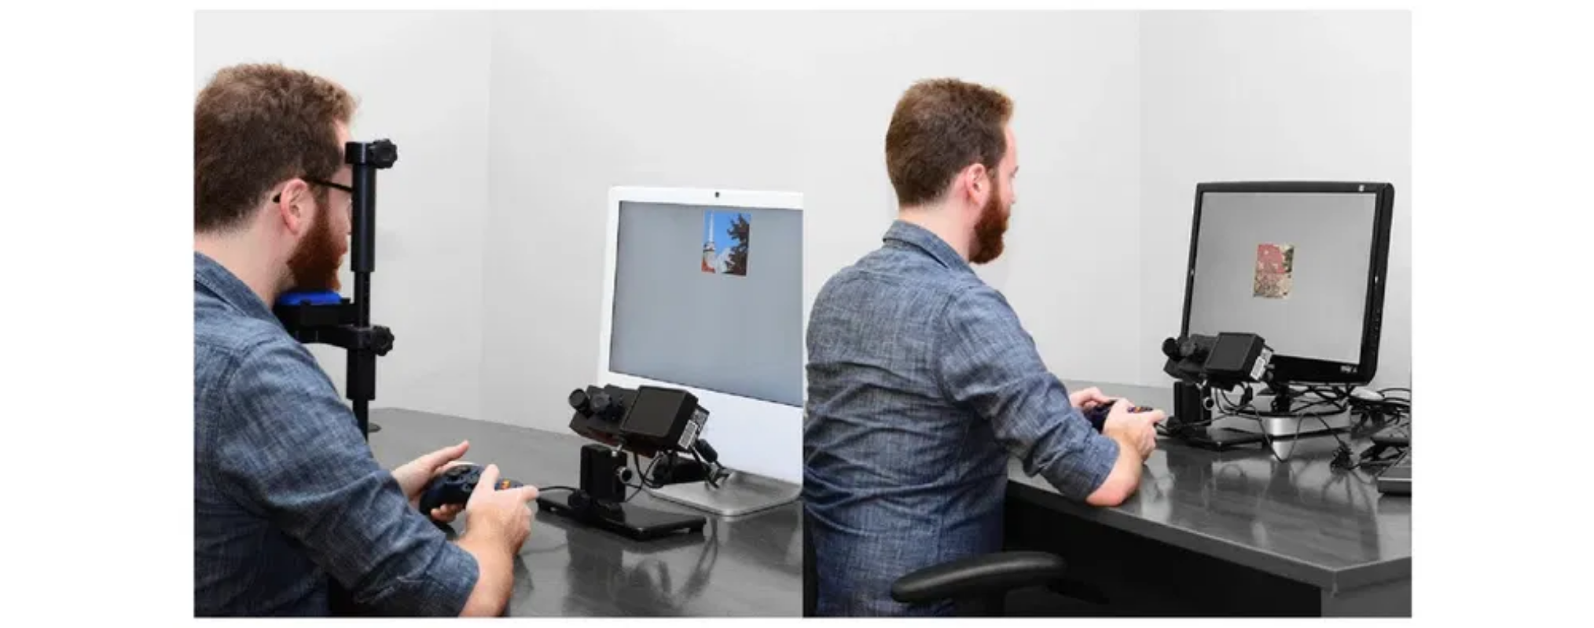







Applications & Future Work
Current Applications
Hands-free control system for differently-abled individuals
Typing assistant for people with motor disabilities
EEG-based alertness detection for drowsiness in drivers
Neuro-gaming interfaces for immersive gaming experiences
Future Work
Integrate Machine Learning (SVM/Neural Net) for adaptive control
Add voice + EEG hybrid interface for enhanced control
Develop real-time web dashboard for BCI monitoring
Enable Android phone control via Bluetooth
Expand to smart home integration for accessibility

Slide 10
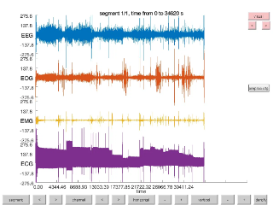

Conclusion
This research showcases the capability of non-invasive BCI systems using low-cost hardware to perform high-level control operations.
By converting neural signals into actionable commands, our system opens new paths in neuro-gaming, assistive technology, and IoT control.
Key Achievements
Successfully implemented a complete BCI system using affordable components
Demonstrated practical applications in assistive technology and gaming
Created an open-source framework for further development and expansion

Slide 11


THANK YOU
Team
NEURAL ADMINS
Tamilnadu Government Polytechnic College (Autonomous), Madurai-11
Department of Computer Engineering
contact@tgpc.edu
www.tgpc.edu

